Slide 1

DEPARTMENT OF ARTIFICAL INTELLIGENCE AND DATA SCIENCE
Project Review
“ IMAGE CLASSIFICATION-BASED RANSOMWARE ATTACK DETECTION USING A DEEP-LEARNING ALGORITHM ”
Project Team Members
Name USN
P N PAVITHRA 1SJ22AD031
SHIRISHA C 1SJ22AD042
VARSHA S V 1SJ22AD057
Project Guide
Ms. Sandhya R
Assistant Professor

Slide 2

ABSTRACT
Ransomware is a significant cybersecurity threat that encrypts data and disrupts systems, making early detection vital. This project introduces an automated ransomware detection system that utilizes Convolutional Neural Networks (CNNs) to analyze executable files as grayscale images. Built with PyTorch, it provides predictions via a Flask web API linked to a MySQL database. At the same time, additional features ensure secure detection without executing files.

Slide 3
PROBLEM STATEMENT
Ransomware attacks are increasing and can easily bypass traditional antivirus systems.
Attackers frequently modify ransomware code, making detection ineffective.
Users remain at high risk of data loss and system disruption due to undetected ransomware
Lack of real‑time alert systems that notify users instantly during ransomware detection.

Slide 4
INTRODUCTION
Ransomware is a highly destructive type of malware that leads to substantial financial losses and operational disruptions for individuals and organizations worldwide. Many attacks go undetected until after files are encrypted, complicating recovery efforts. Traditional detection methods often fail against new ransomware variants and may require executing suspicious files, introducing security risks. A safer approach is static analysis, but manual inspection of binary data is complex and time-consuming. By converting executable files into grayscale images, it's possible to extract meaningful patterns. Convolutional Neural Networks (CNNs) can learn these patterns, allowing them to differentiate between ransomware and legitimate software. The project proposes a CNN-based detection system that analyzes executables without execution, providing an efficient and accurate method for modern ransomware defense.

Slide 5
OBJECTIVES
Improve detection accuracy and robustness using diverse malware and benign datasets.
Enhance model generalization through regularization techniques such as dropout, data normalization, and adaptive learning rate optimization.
Enable automated ransomware detection without executing files to ensure system safety.
Reduce computational complexity and inference time to support real-time scanning and monitoring on web and desktop platforms.

Slide 6
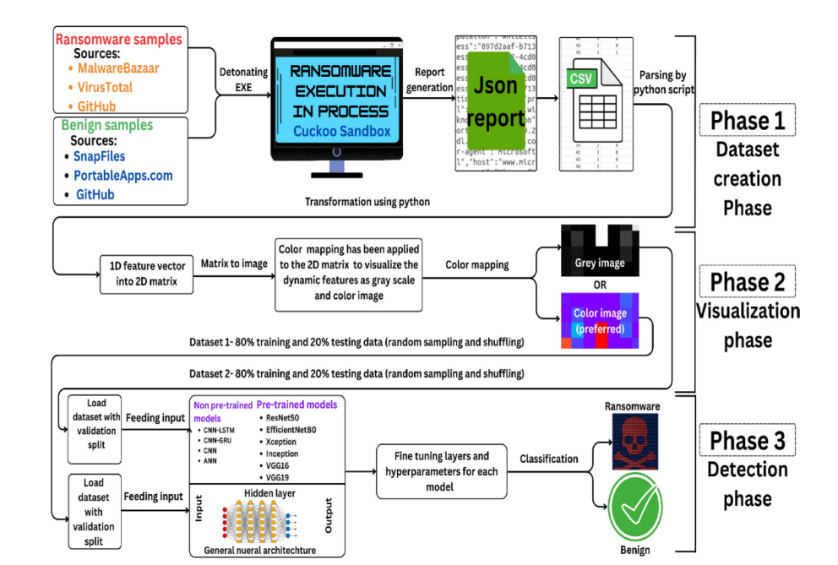
DESIGN AND ARCHITECTURE
Model Architecture

Slide 7
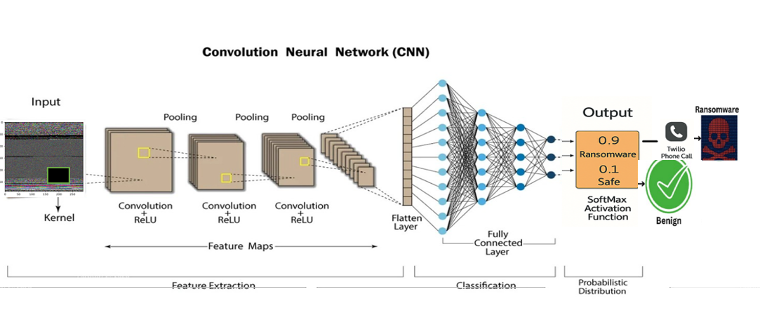
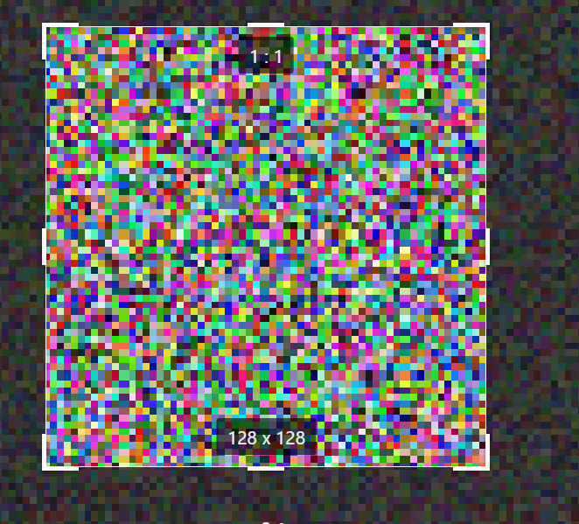
128 x 128
64 x 64
32 x 32
16 x 16
8 x 8

Slide 8

METHODOLOGY
1. Data Collection: Collected ransomware executable samples from Malware-Bazaar, Virus-Total, and GitHub.
Collected benign executable samples from Snap-Files, Portable-Apps, and GitHub.
2. Data Preprocessing: Read raw binary bytes from executable files using Python, convert byte streams into fixed-length sequences.
Reshaped 1D byte data into 2D matrices. Mapped matrices to grayscale images using byte-to-pixel intensity mapping.
Split the dataset into 80% training and 20% testing data with random shuffling.
3. Model Development: Designed a CNN-based deep learning model using PyTorch.
Used convolutional layers to extract visual patterns from malware images.
Applied ReLU activation and dropout for regularization.
Used dense layers for binary classification (Ransomware / Benign).
Generated prediction confidence using Softmax.
4. Deployment and Detection: Deployed the trained model using a Flask web API. Integrated MySQL database for user authentication and prediction history.
Developed a cross-platform Electron desktop application.
Enabled real-time file scanning and directory monitoring for automated ransomware detection.

Slide 9
MODULE SPLIT-UP
LIST OF MODULES
Data Collection & Preprocessing Module
CNN Model Training Module
Prediction & Analysis Module
Deployment & User Interface Module

Slide 10
Module 1: Data Collection & Preprocessing: Executable files are collected and transformed into a format suitable for deep learning analysis.
Purpose in the Model:
Collects ransomware and benign executable samples from trusted sources.
Reads raw binary data from executable files.
Converts byte streams into grayscale images using byte-to-pixel mapping.
Prepares standardized input data for CNN processing.
Module 2: CNN-Based Ransomware Detection: A Convolutional Neural Network is used to learn patterns from grayscale executable images.
Purpose in the Model:
Automatically extracts meaningful visual features from images.
Identifies ransomware-specific textures and structural patterns.
Classifies files as Ransomware or Benign with high accuracy.
Handles unknown and previously unseen ransomware variants.
Acts as the core intelligence of the system.

Slide 11
Module 3: Prediction & Analysis: The trained CNN model analyzes executable files and generates detection results.
Purpose in the Model:
Performs static analysis without executing files.
Produces prediction labels with confidence scores.
Extracts additional features such as file entropy and hashes.
Supports decision-making through detailed analysis output.
Module 4: Deployment & User Interface: The detection system is deployed through web and desktop applications.
Purpose in the Model:
Provides a Flask-based backend for model inference and API access.
Stores user data and prediction history using MySQL.
Offers a web interface for manual file scanning.
Uses the Twilio API to send voice call alerts when ransomware is detected.

Slide 12
IMPLEMENTATION
CNN (Convolutional neural network)
Input Layer: Takes an uploaded image (PNG/JPG) and converts it into a standardized format (grayscale, resized to 128×128).
Convolution Layers: Extract key spatial features such as edges, texture patterns, and malicious artefacts present in ransomware-infected files.
Activation (ReLU): Highlights important patterns.
Pooling Layer: Reduces dimensionality or size while preserving essential feature patterns.
Fully Connected Layer: Converts extracted features into class scores:{Ransomware, Legitimate}.
Soft-max Probability: Produces final confidence score and class label.

Slide 13

CNN Implementation
# Load image and preprocess
img = Image.open(io.BytesIO(file.read())).convert("L")
img = transform(img).unsqueeze(0).to(device)
# Predict using the DeepCNN model
with torch.no_grad():
output = model(img)
prob = torch.softmax(output, dim=1)[0]
pred = torch.argmax(prob).item()
# Final label
label = "Ransomware" if pred == 1 else "Legitimate"
Twilio Alert Implementation
# Twilio client
client = Client(ACCOUNT_SID, AUTH_TOKEN)
# Make alert call when ransomware is detected
def make_alert_call():
client.calls.create(twiml='<Response><Say>Alert! Ransomware detected.</Say></Response>', from_=TWILIO_NUMBER, to=USER_PHONE)
# Trigger alert
if label == "Ransomware":
make_alert_call()

Slide 14
2. Twilio Alert
Event Trigger: When the CNN classifier detects Ransomware.
Twilio Client Initialization: Uses secure credentials (ACCOUNT_SID, AUTH_TOKEN).
Alert Mechanism: Initiates an automated phone call to the registered user.
Voice Message: Plays a spoken alert: “Ransomware detected. Please take immediate action.“
Notification Delivery: User receives a real-time phone call alert for critical threat detection.

Slide 15
TESTING
1. UNIT TESTING:
Test Name | Test Description | Input | Expected Output | Actual Output | Test Result
Image file validation | Validate supported image formats | .png , .jpg , .jpeg | File accepted | File accepted | Pass
Image preprocessing Model prediction | Check resizing, grayscale conversion &normalization Validate softmax probability output | Uploaded image Preprocessed tensor | Tensor(1x1x128x128) Two-class probability (Ransomware /Legitimate) | Correct tensor generated Correct probabilities returned | Pass Pass
2025-26
15

Slide 16
2. INTEGRATED TESTING:
Test Name | Test Description | Input | Expected output | Actual output | Results
Full pipeline execution | Test upload-> preprocess -> predict flow | Normal image | Legitimate file | Legitimate file | Pass
Ransomware detection | Check if CNN detects malicious image | Ransomware image | Ransomware detected | Successfully detected | Pass
Alert function trigger | Validate Twilio call after detection | Prediction = ransomware | Phone call initiated | Call triggered successfully | Pass

Slide 17
3. SYSTEM TESTING:
Test name | Test Description | Input | Expected output | Actual output | Results
End –to-end workflow | Validate entire system performance | Image uploaded via web UI | Full workflow completes | Work correctly | Pass
Response time check | Measure system speed | Multiple test images | < 2 sec response time | 1.2-1.5 sec observed | Pass
Error handling | Validate behaviour for invalid inputs | .txt , .pdf , corrupt image | “Invalid file format “ error | Error displayed correctly | Pass

Slide 18
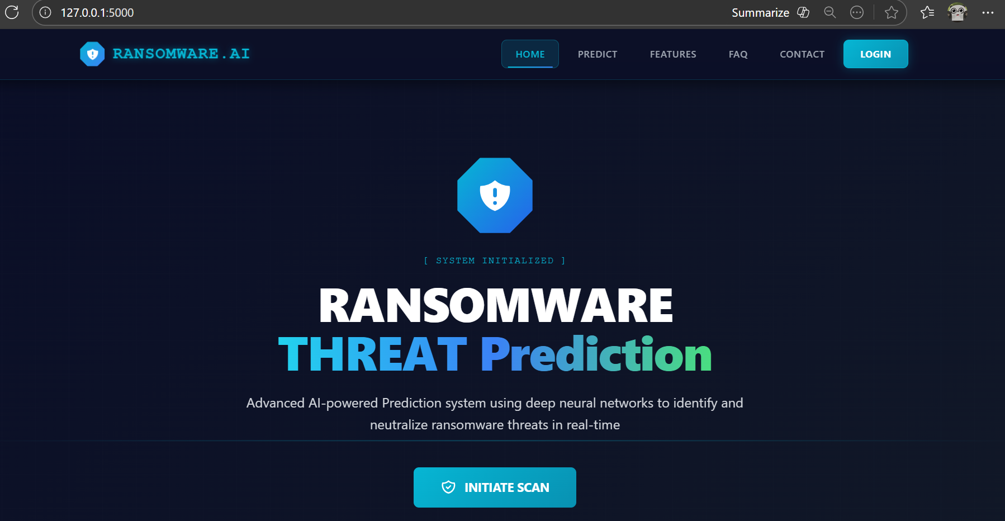
SCREENSHOTS OF OUTPUTS

Slide 19
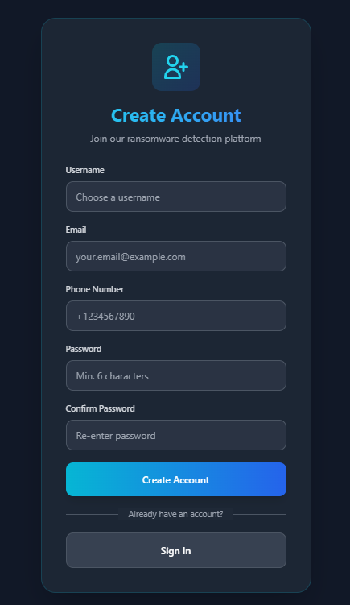


Slide 20
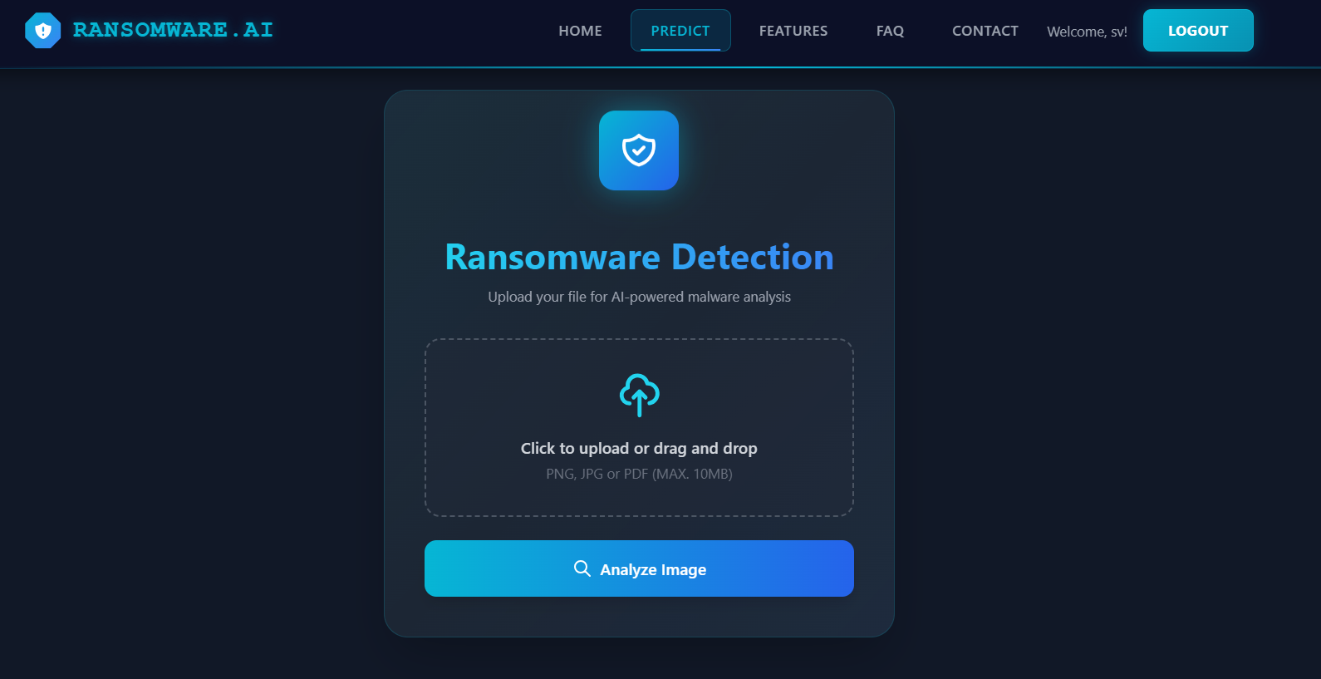

Slide 21
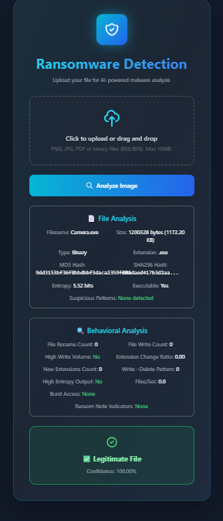
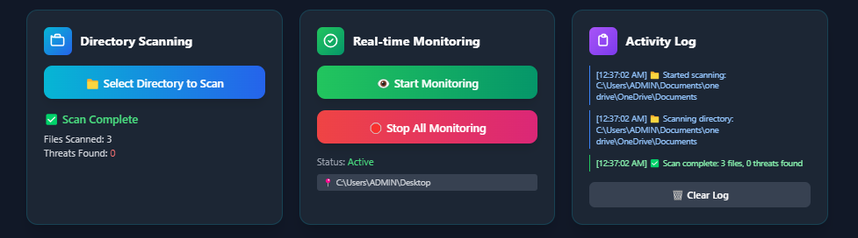

Slide 23
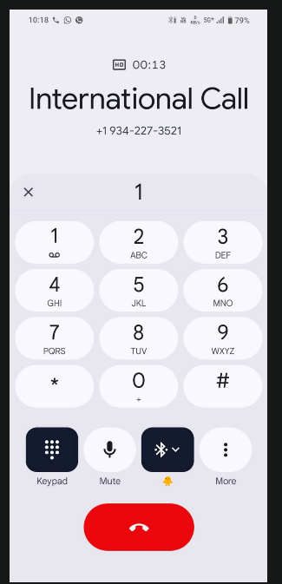
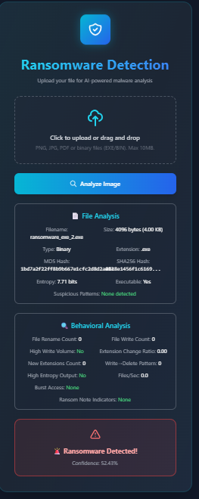

Slide 24
CONCLUSION
The project successfully detects ransomware with a CNN. The system gives fast and accurate results through a user-friendly web application. Real-time Call alerts make the system more reliable and useful for early warning. Overall, the project proves that deep learning can detect ransomware effectively before it causes damage.
FUTURE ENHANCEMENTS
Add support for more ransomware families to improve accuracy. Build a real-time monitoring system that scans files automatically without user upload. Create a desktop or mobile app version for easier use. Add cloud storage protection and automatic file isolation when a threat is detected. Improve alert features by sending email alerts and logging to the dashboard.

Slide 25
REFERENCES
Alraizza, A., & Algarni, A. (2023). Ransomware detection using machine learning: A survey. Big Data and Cognitive Computing, 7(3), 143.
Kok, S., Abdullah, A., Jhanjhi, N., & Supramaniam, M. (2019). Ransomware threat and detection techniques: A review. Int. J. Comput. Sci. Netw. Secur, 19(2), 136.
Musonda, M., Zimba, A., & Sinyinda, M. (2023). Machine learning-based crypto ransomware detection model on Windows platforms. ICICT-Zambia, 5(1), 141-147.
Ganfure, G. O., Wu, C.-F., Chang, Y.-H., & Shih, W.-K. (2022). Deepware: Imaging performance counters with deep learning to detect ransomware. IEEE Transactions on Computers, 72(3), 600-613.
Almomani, I., et al. (2021). Android ransomware detection using a hybrid evolutionary approach. IEEE Access, 9, 57674-57691.

